Slide 1
Scientific Posters

Slide 2
Scientific Posters
Significant contribution to a meeting
Part of professional education
Provides information
Develops your experience
Builds networks and contacts
Source of feedback

Slide 3
What is a scientific poster?
A document used to communicate your research to a large group of people in intimate setting in 10 minutes or less.
Informative teaser that invites someone in…
You can get the purpose of the work in 20 seconds
Poster usually highlight the most interesting aspect of the work, not the entire piece of work

Slide 4
Most people spend 90 seconds at a poster
People come close when the items they read from afar appeal to them
Crowded, disorganized posters are passed over
Posters normally draw those with real interest who want to discuss the work

Slide 5
The Audience
Who reads your poster?
  Those who follow your work
  Those in the same research area
  Passers-by
Be ready to give a one - two minute introduction
Rehearse answers to common questions
Let the audience guide your discussion
Only 1-2 will come at a time

Slide 6
Characteristics of effective presentations:
Organized
Rehearsed
Visual appeal
Relevant to audience
Demonstrates enthusiasm

Slide 7
Poster Components
Title
Authors & lab affiliation
Funding sources
Light introduction
Materials & Methods
Results
Literature Cited
Further Information

Slide 8
Title
Catchy 1 -2 lines
Avoid the use of colons and cutesy / humorous terms
Short and succinct is best
Should allude to the research
Sentence Case (ALL CAPS IS BAD!)

Slide 9
Authors & Affiliations
List authors of the work which include PI and all other contributors
Order of authors is determined by PI – very important
Affiliation is the physical location where work was completed and the “home” of the PI
Gain permission form PI prior to submitting any work for poster, oral or written communication

Slide 10
Funding
You must list all funding sources for the work
For our purpose this year it is NSF-REU program for funding your stipend.
A grant program that is funding the actual research should also be listed (ask PI).
Normally research presented without a funding source is suspect. Peer review grants give the work credibility.

Slide 11
Introduction
Maximum of 200 words
Quickly place your issue in the context of published, primary literature; provide description and justification of general experimental approach, and hint at why your study organism is ideal for such research; give a clear hypothesis.

Slide 12
Materials & Methods
Max 200 words
Briefly describe unusual or unique materials or methods used in the research
Diagrams are best for instrumentation
Flow charts help with experimental details

Slide 13
Results
Unless the poster is about method creation, this will be the largest portion of the poster
Includes appropriate raw data, interpretation of that data
Be sure to address how this fits the hypothesis
Visual aids: tables, graphs, computer generated illustrations, structures

Slide 14
Conclusions
Frame the results in the context of the hypothesis
List challenges and major advancements
Connect to the literature
Outline future directions of the work

Slide 15
Literature Citation
Cite only references directly related to your work.
Usually 5 key citations
Use ACS Style for chemistry work or other appropriate citation format

Slide 16
Miscellaneous
Further Information: A URL that others can access for more information or perhaps a short handout; optional
Logos: You should include logos for the funding agencies and perhaps the institution for where the research took place
Acknowledgements: People who contributed to work, less than 40 words

Slide 17
Size and font
Title should be readable from 6 feet
  120 font Helvetica, Arial, Universe
Sub-heading from 3 feet and text from 2 feet.
  60 font
Text total : 800 words or less.
  24 font, Times, Palatino, Bookman
No block of text longer than 10 lines
Italics instead of underlining
Block letters, mixed case, no script

Slide 18
Formatting & Space
Easier to read vertical text formatting than horizontal formatting
Three column maximum
Read top to bottom, left to right
Be sure to leave at least a one inch margin all around
About 25-30% white space is needed to keep the poster readable

Slide 19
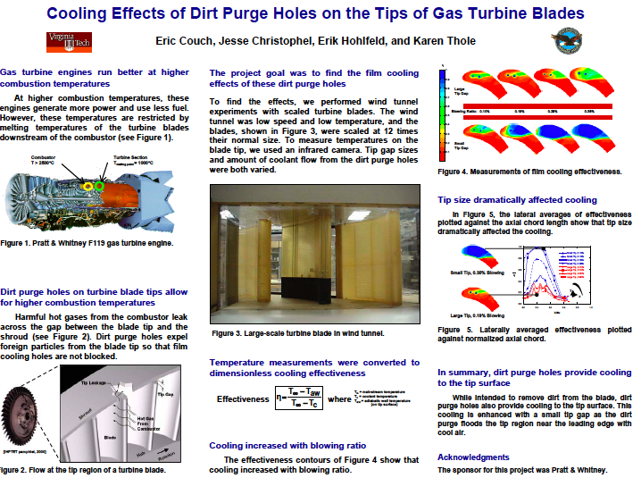

Slide 20
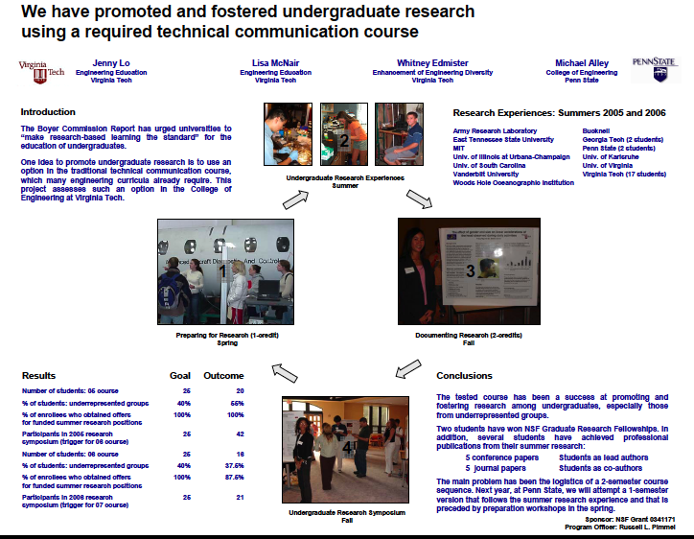

Slide 21
Visual Balance and Symmetry
Your poster should have a good visual balance of figures and text, separated by white space. Balance occurs when images and text are reflected (at least approximately) across a central horizontal, vertical, or diagonal axis. This axis is know as the axis of symmetry

Slide 22
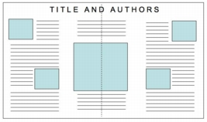
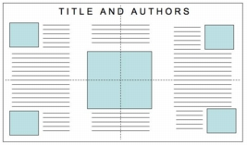
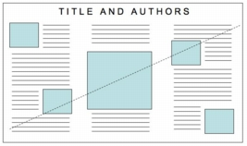
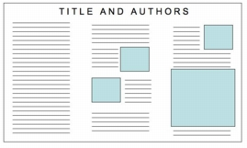
http://www.ncsu.edu/project/posters/NewSite/CreatePosterLayout.html

Slide 23
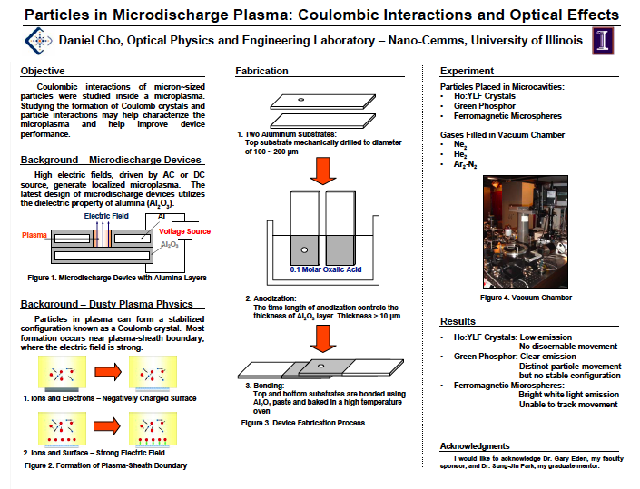

Slide 24
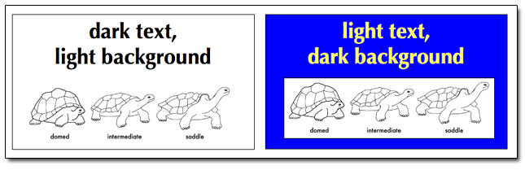
Color Theory
Text should be in black, highlights in color
Best if background is white or light colored

Slide 25
Color Theory
Be careful of red-green colorblindness
Gratuitous use of color districts the reader
Keep headings and titles in the same color
Keep highlight colors to three
Pastels and yellow are not good for text or graphics especially in large rooms with poor lighting

Slide 26
Graphs
Do not use red-green color combo because of color blindness
Do not use yellow because it is unreadable from 3 feet and gets lost in fluorescent lighting
Line graphs only 3 lines
Bar graphs, no more than 6 bars
Avoid complex graphs- take too long to decipher

Slide 27
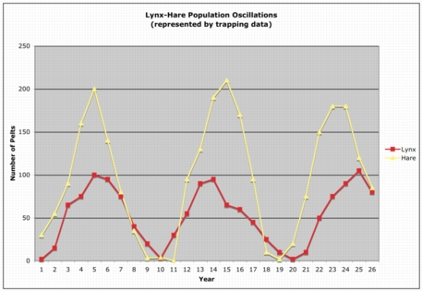
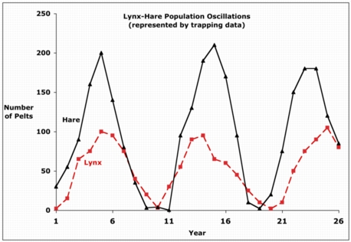
http://www.ncsu.edu/project/posters/NewSite/CreatePosterGraphics.html

Slide 28
Photos
A thin black outline makes photos pop
Good quality, high-resolution photos only
At least 4x5 if you want to highlight details
Need resolution of at least 300 (dots per inch) for good resolution when printed

Slide 29
Tables
Avoid a table if a graph or other illustration can be used
Make tables compact and include only the necessary data

Slide 30
Final Steps
Have a friend review the poster for content and format before printing
Proofread, proofread, proofread
Allow 3-4 days for printing
Have fun !

Slide 31
Your Attire
If your attire matches and does not clash with the poster, it will be visited more often and for longer periods
Business attire, no flashy bling, no perfume or scented hygiene products
Clothes freshly pressed
Smile, keep your breath fresh
Notes:
Keegan, D.A., and S.L. Bannister. 2003. Effect of color coordination of attire with poster presentation on poster popularity. Canadian Medical Association Journal 169:1291-1292.

Slide 32
Templates
Postersession.com
MakeSigns.com
PowerPoint

